Slide 1
Branching

Slide 2
Branching
Branching in Git helps us to define workflows that make sure the code that is being delivered is in the best state possible, minimising risks for any errors or crashes.
With Version Control Systems, like Git, we can separate the codebase on to many different branches.
This feature can be utilised for isolating the development and testing of new features from working code that is running on a production environment.

Slide 3
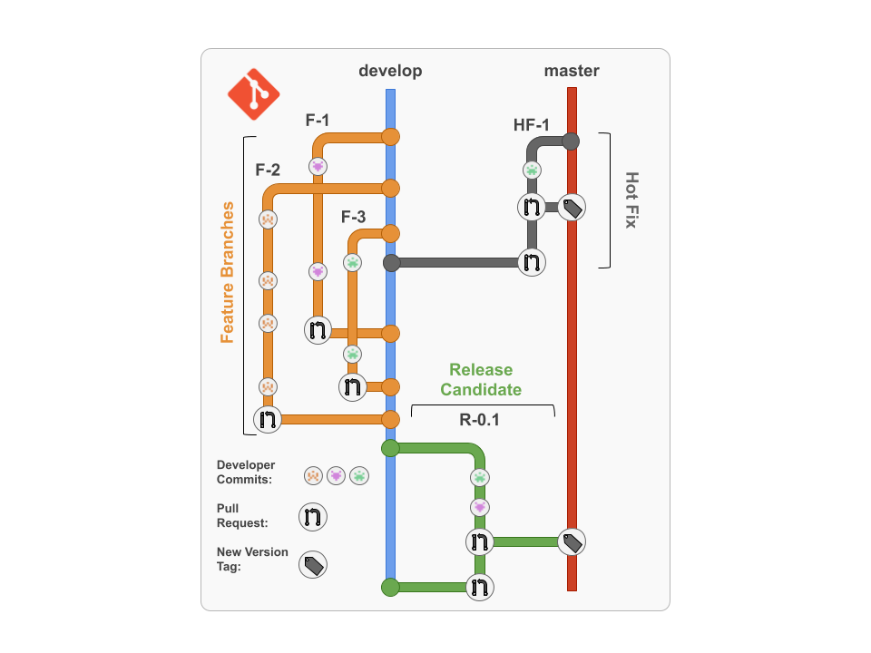
Workflow Example

Slide 4
New Application Features

Slide 5
Releases

Slide 6
Hot Fixes

Slide 7
Creating and Branches
Command | Function
git branch | Show all branches in current repository
git branch [NEW_BRANCH_NAME] | Create a new branch
git checkout [BRANCH_NAME] | Switch to a branch
git checkout -b [BRANCH_NAME] | Switch to a branch; create branch if it doesn’t exist
git branch -d [BRANCH_NAME] | Delete a branch
git push --delete origin [BRANCH_NAME] | Delete a branch in your remote repository

Slide 8
Merging Branches
E---F---G issue
/
A---B---C---D master
E---F---G issue
/ \
A---B---C---D---H master

Slide 9
Conflicts
This would cause a conflict when trying to merge at commit H
app.py at commit D | app.py at commit G
hello = “Hello World!” print(hello) | user = “Harry” hello = f“Hello ${user}” print(hello)

Slide 10
Reverting
Reverting in Git is a forward-moving way of undoing changes on a repository.
Reviewing the history of a repository
Command | Function
git log | Shows the commit history of the current branch
git log [BRANCH_NAME] | Passing an argument through allows you to display the commit history of a specific branch
git log --oneline | Shows a simplified view of the commit history
git log --branches=* | Shows the commit history for all branches in the current repository

Slide 11
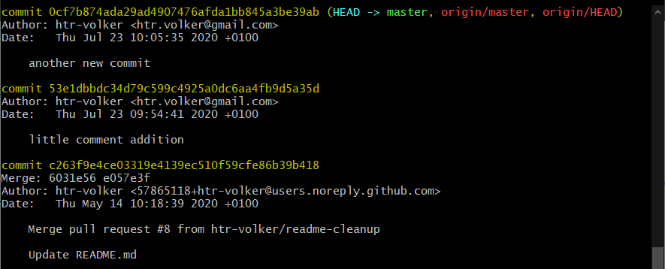
When you run git log, it should look like this

Slide 12
Reverting to a previous commit
Here you would refer to a commits hash code e.g. 483856a
Command | Function
git revert [COMMIT] | Creates new commit that reverts changes to the code its state at the specified commit
git revert HEAD | Creates a new commit that reverts the repository back to the state of the previous commit
git reset --hard [COMMIT] | Reverts changes to the code to the state at the specified commit and discards the history after that point

Slide 13
Reverting with reset
git reset --hard bcabb84
This command will return the state to the selected commit
Using Revert to go Back to the Latest Commit
git reset --hard

